Slide 1
Financial Choices:
Needs, Wants & Savings
Financial Literacy: Session 1

Slide 2
About the Program
What is a Financial Literacy Ambassador: A financial literacy ambassador informs others about the importance of financial awareness and smart ways to handle money.
What we will be Presenting Today: Today we will be presenting about Financial Choices; specifically, the needs and wants of a person, and how to save money.

Slide 3
Needs Vs Wants
Ask yourself “Is this something I need to survive?” If yes, this is a need.
As yourself “Is this something that would improve your quality of life"? If yes, this is a want.

Slide 4
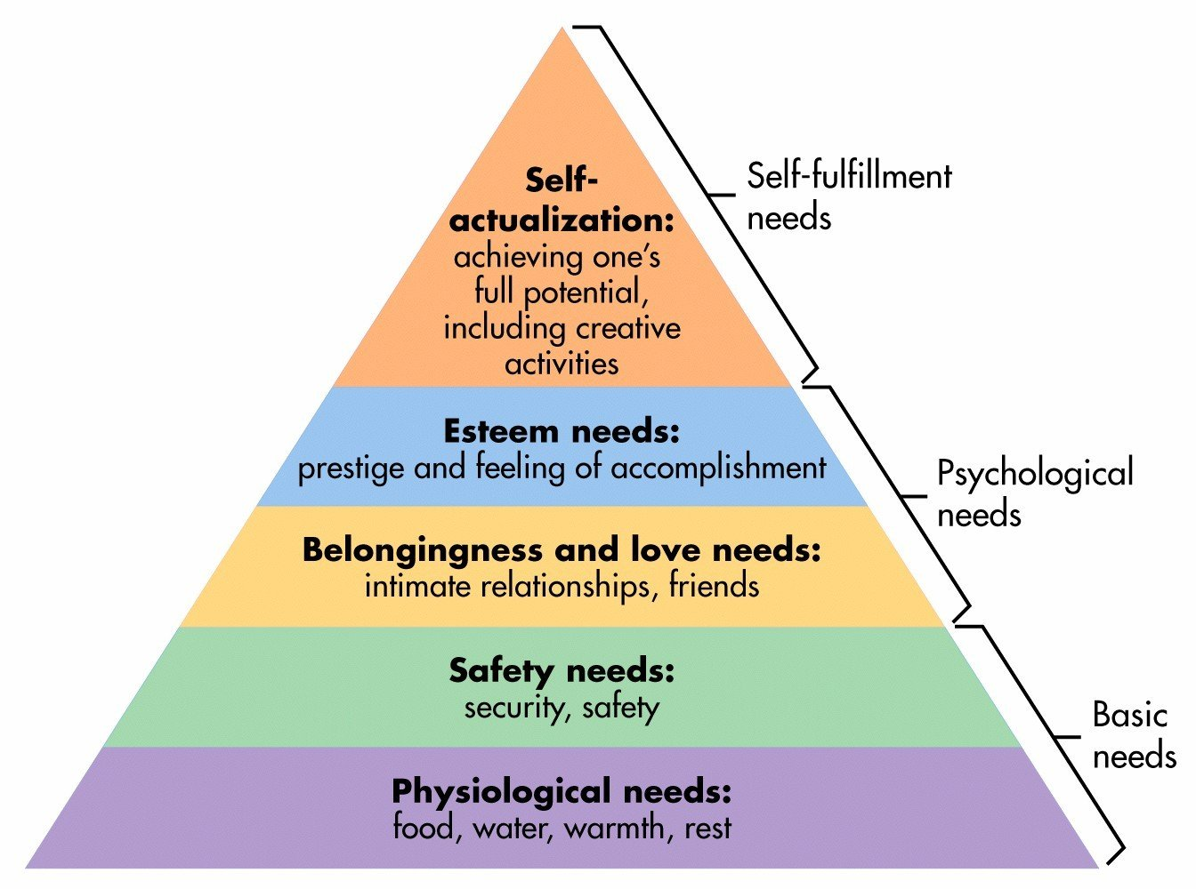
When Does A Need Become A Want?
Needs become wants when you are meeting your basic needs yet doing so above your ‘means’.

Slide 5
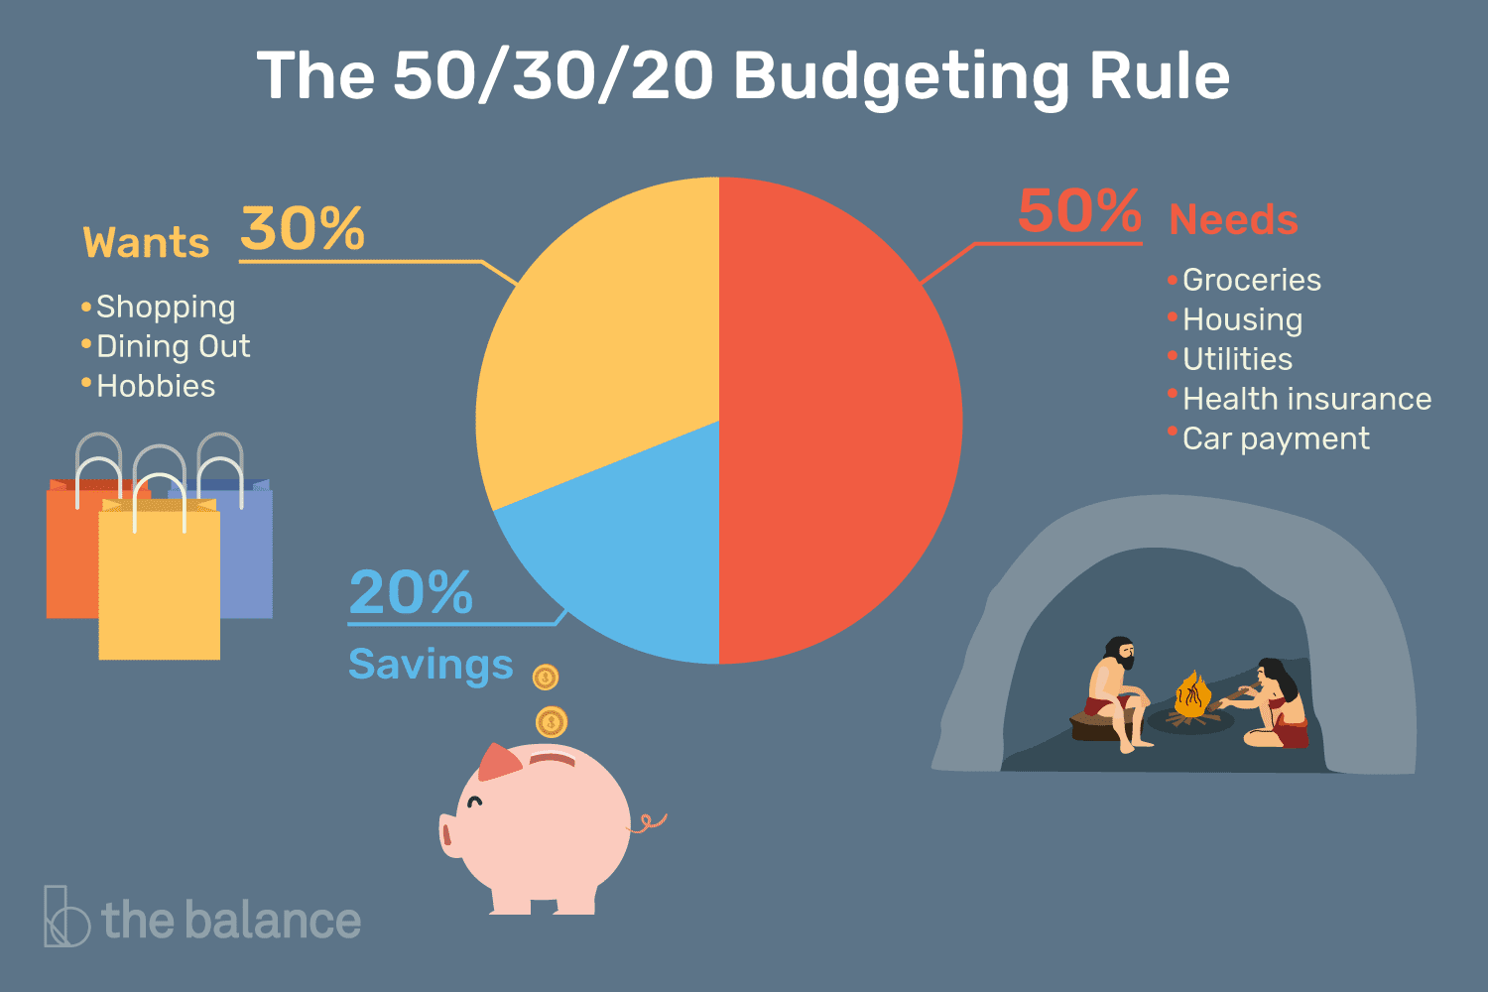
50/30/20 Budget Rule
Necessities
Wants
Savings and Paying off Debts

Slide 6
Applying What We Learned
Here are some money-saving tips
Eating food at home/ dorm instead of going out to eat
Renting textbooks instead of buying them
Do not buy things just because they are on SALE
Save up loose change
Do not save your card information on online websites
Create a budget
Buy in bulk
Eliminate recurring costs- sharing subscriptions with friends
Utilizing student discounts

