Slide 1
Holidays Spending
Financial Literacy: Session 3

Slide 2
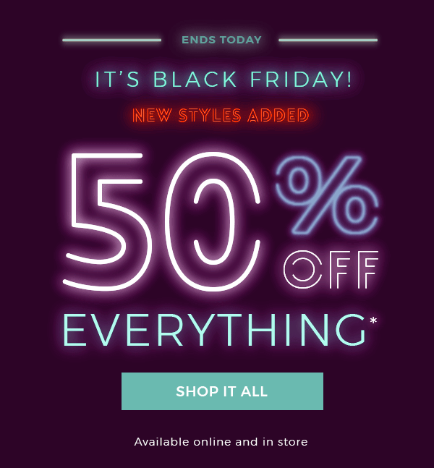
The Black Friday Trap
About 17 percent of items were more expensive on Black Friday in 2016 than they were the week before on Amazon.com

Slide 3
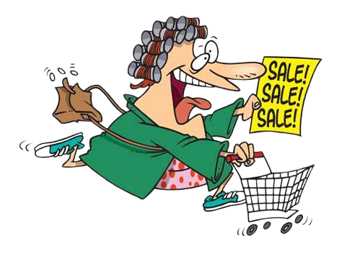
Values & Attitudes
Values- Strongly held beliefs that guide our behavior and reflect what we think is right or wrong
Attitude- Are more flexible and reflect one's current life situation, likes, and dislikes
Values-Attitudes-Emotional Reaction= Behavior
Notes:
E.G- someone who values saving and beliefs that one should only buy necessary items; however, during Black Friday, this individual buys the latest iPhone amongst other items.
If our attitudes do not reflect our values it results in mental conflict

Slide 4
Activity Time!
Write down 3-5 core values that you have regarding spending
Do your attitudes align with these values?

Slide 5
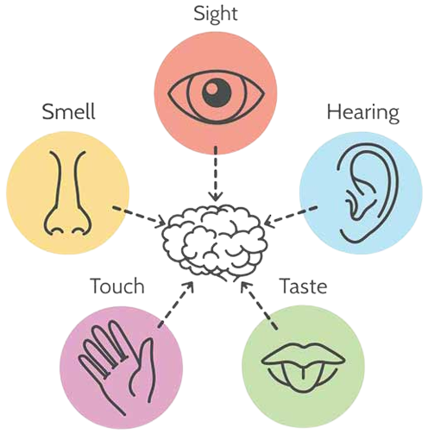
How Do Stores Promote Spending
https://youtu.be/WXQTte5wGGI

Slide 6
Questions to Consider Prior to Spending
1. Will I really use this product?
2. Do I own anything else that provides the same use?
3. Am I motivated to buy this item because it is branded?
4. Did the salesperson influence my desire for this item?
5. Where will I put it?
6. What is the financial cost of this purchase, and can I really afford it?
7. What if I wait?
8. What else will I have to give up to afford this?
9. Will this purchase make me feel guilty?

Slide 7
Ways to Save Money During the Holidays?
Make it a potluck where everyone brings a dish
Get creative with gifts e.g., Secret Santa
Plan before buying gifts to stay on target
Rent outfits- rent the runway, le tote, Gwynnie Bee
Set a budget and stick to it
Stick to simple recipes
Do it yourself centerpieces and other decorations
Make use of coupons and discounts

