Slide 2
The FAFSA hour

Slide 3



Slide 4
Why fill out the FAFSA?
The FAFSA is the Free Application for Federal Student Aid. It is a free application that is open to all citizens and eligible non-citizens.
  It’s Free.
  It only takes 20 minutes.
  You may qualify for “free money.”
  It can be sent to 10 schools at once.
  Sometimes you can qualify for financial assistance when you least expect it.
  IT helps you make informed decisions.
  Completing the FAFSA is the gateway to federal aid in the form of grants, loans and work study.

Slide 5

What will you need?
Your FSA ID
All of your personal information
20 minutes and a smile

Slide 6
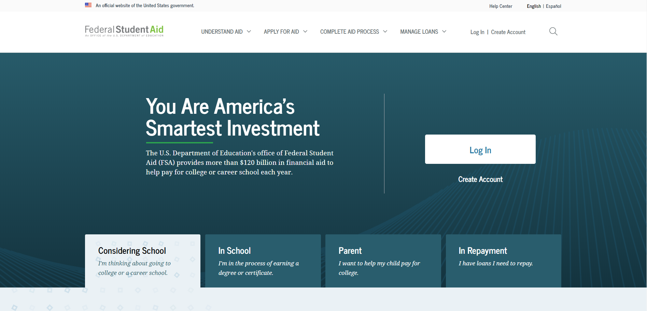
Getting started
Go to StudentAid.gov.
Select the “Create Account” button

Slide 7
2021-22 fafsa.gov preview presentation
September 2020
Notes:
2021-22 title slide.

Slide 8
Home View page
Home view
Notes:
2021-22 Home title slide.

Slide 9
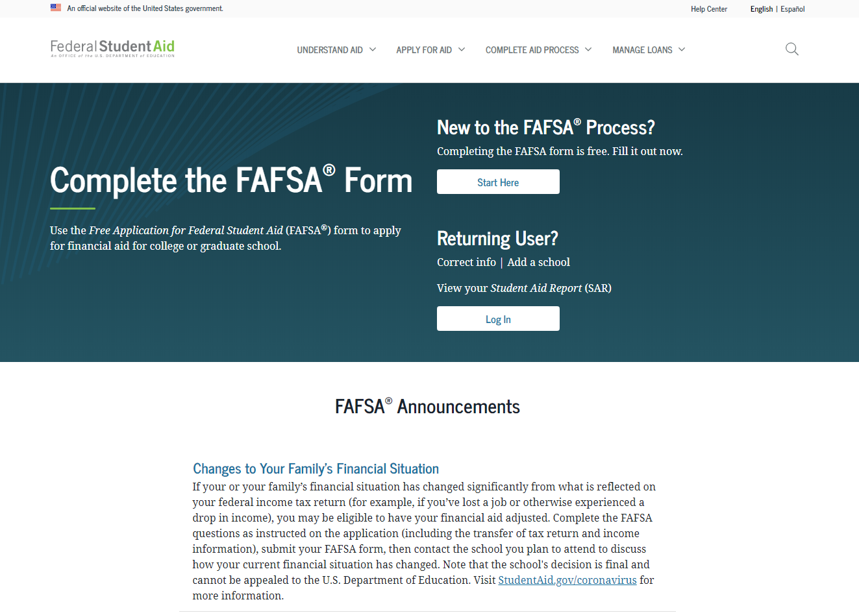
FAFSA.gov Homepage – Top Section
Notes:
2021-22 fafsa.gov home view.
The fafsa.gov home view features a two-button login option and current announcements, as well as an easy-access tool bar, featuring links to applying for aid and loan information.

Slide 10
Login Title page
Login
Notes:
Login title slide.

Slide 11
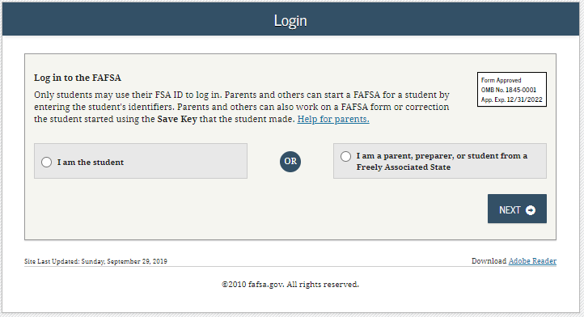
Login
Notes:
2021-22 “Login” view.

Slide 12
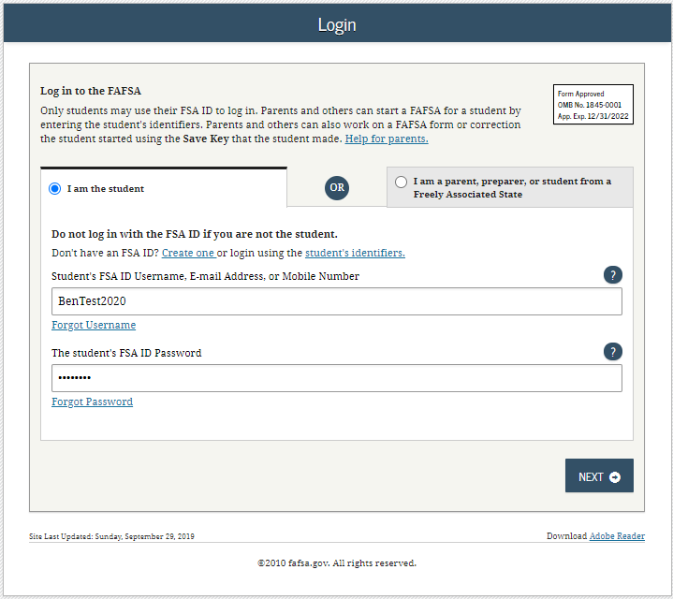
Login – I am the Student
Notes:
2021-22 “Login” view with the “I am the student” option selected.
Note: If using this option, the applicant can choose one of three ways to log in to the application: using an FSA ID, a verified email address, or a verified phone number.

Slide 13
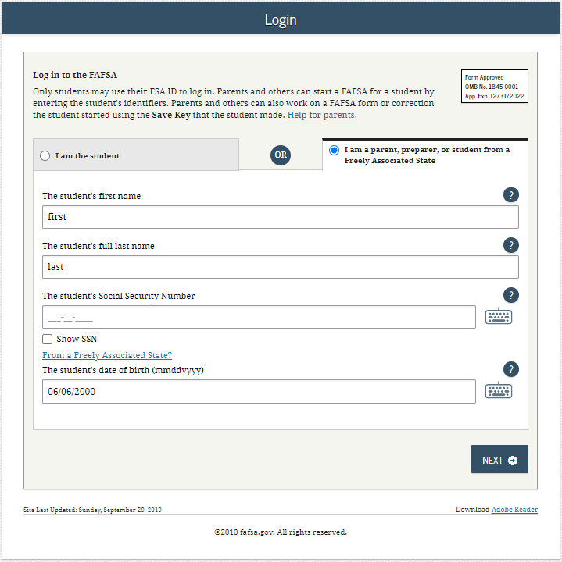
Login – I am a parent, preparer, or student from a Freely Associated State
Notes:
2021-22 “Login” view with the “I am a parent, preparer, or student from a Freely Associated State” option selected.
The SSN is masked by default and users have the ability to check the “Show SSN” box if they wish to see what is being typed in.

Slide 14
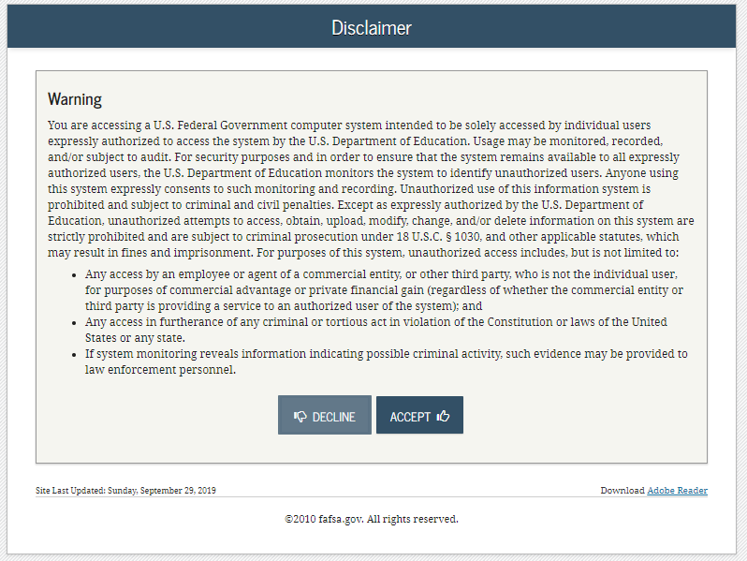
Disclaimer
Notes:
2021-22 “Disclaimer” view.

Slide 15
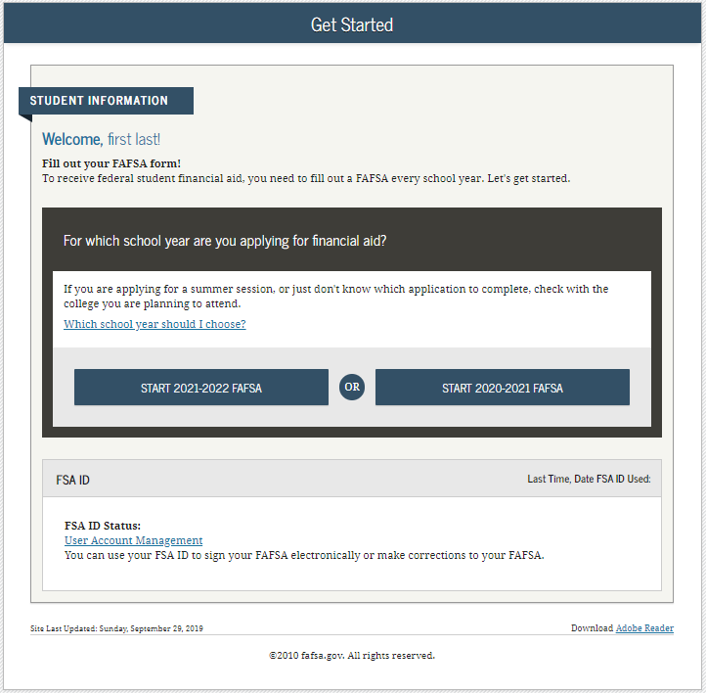
Get Started
Notes:
2021-22 “Get Started” view.

Slide 16
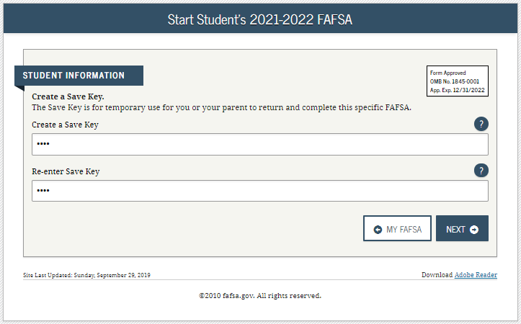
Create a Save Key
Notes:
2021-22 “Create a Save Key” view.
The Save Key allows an applicant to save their Free Application for Federal Student Aid (FAFSA®) form and return at a later time to complete and submit the application. The application is saved for 45 days, unless the applicant submits their application for processing prior to that. Additionally, the Save Key provides applicants a way to share access to their FAFSA form or correction if their parent(s) needs to add information or sign it.

Slide 17
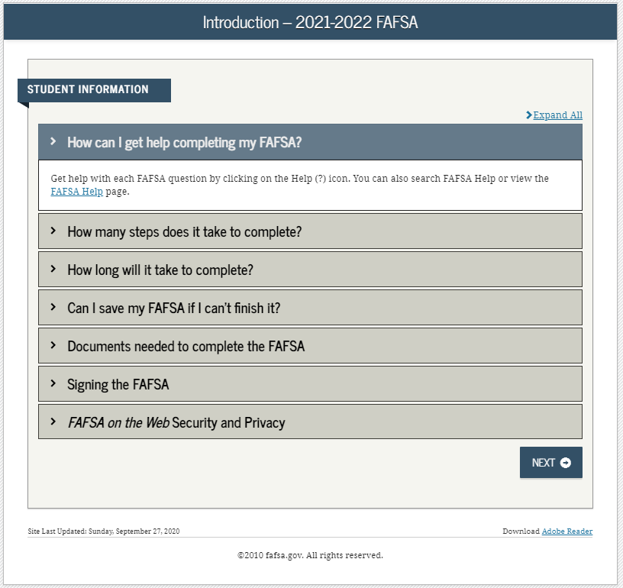
Introduction
Notes:
2021-22 “Introduction” view.
Each topic has accordion functionality that can be expanded and contracted to reveal or conceal additional information.

Slide 18
Dependent Student with Parental Data
Dependent Student with Parental Data
Notes:
Dependent Student with Parental Data title slide – logged in as an applicant.

Slide 19
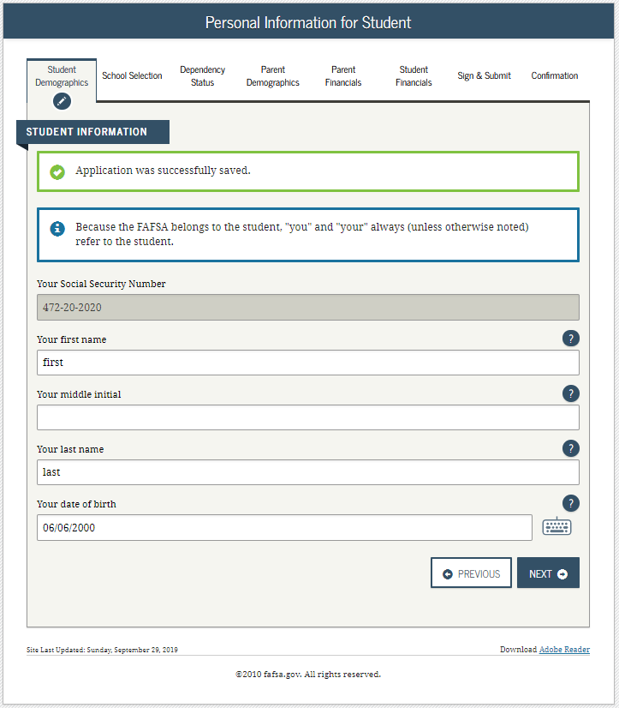
Dependent Student– Student Demographics
Notes:
2021-22 “Personal Information for Student” view.
This is one of multiple pages on fafsa.gov that explains that “you” and “your” are referencing the applicant. Other pages where this messaging appears includes the Search for High School, Student Marital Status, Parent Marital Status, and Student Tax Filing Status.
The box highlighted in green indicates that the application has been successfully saved.
Note: This is the first view for the Student Demographics section.

Slide 20
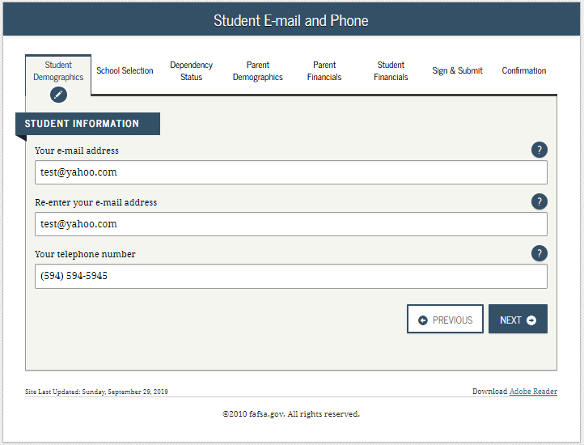
Dependent Student – Student E-mail and Phone
Notes:
2021-22 “Student E-mail and Phone” view.
Note: While not mandatory, it is beneficial for the applicant/parent to include an e-mail address on the FAFSA form in order to receive important communications about their financial aid.

Slide 21
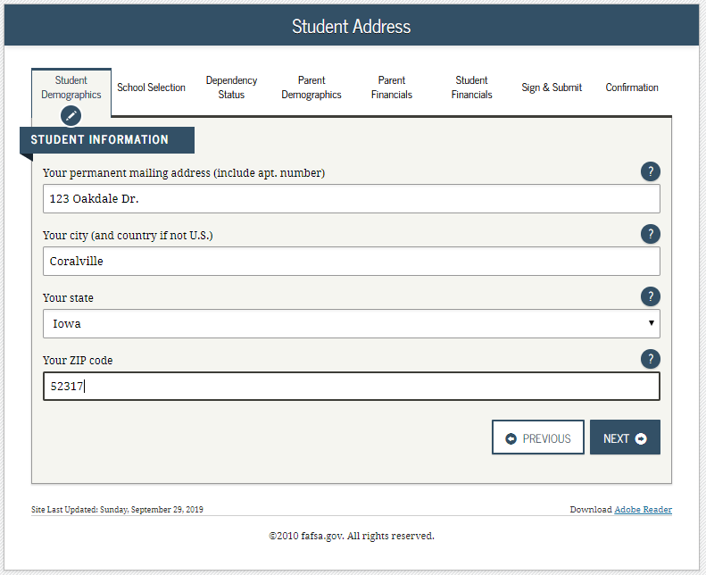
Dependent Student – Student Address
Notes:
2021-22 “Student Address” view.

Slide 22
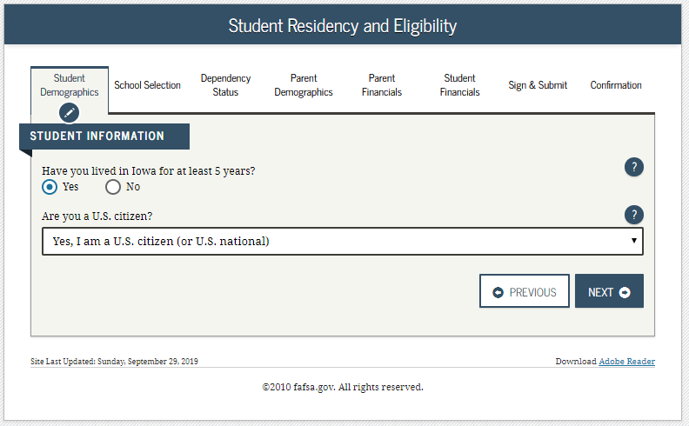
Dependent Student – Student Residency and Eligibility
Notes:
2021-22 “Student Residency and Eligibility” view.

Slide 23
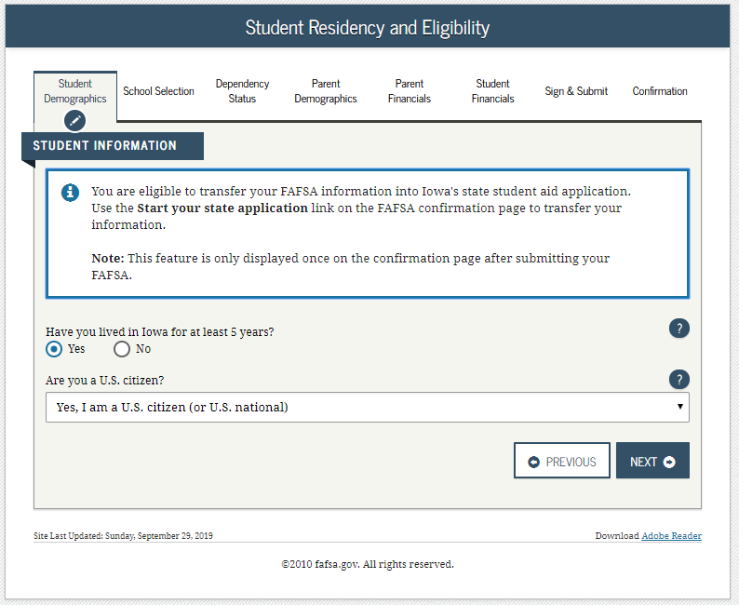
Dependent Student – State Aid Eligibility
Notes:
2021-22 “Student Residency and Eligibility” view continued.
The informational message displays to notify the applicant that they are eligible to transfer their FAFSA information to their participating state aid application. The link will be available on the FAFSA confirmation page. This message will only display when the applicant indicates a participating state as their state of legal residence.
Participating states include: Iowa, Minnesota, Mississippi, New York, New Jersey, Pennsylvania, and Vermont.

Slide 24
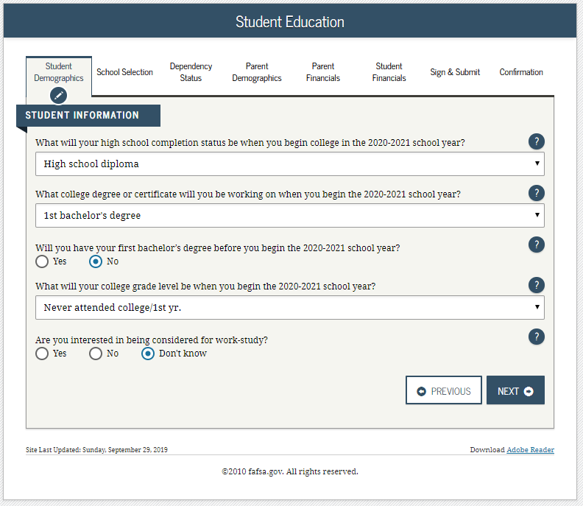
Dependent Student – Student Education
Notes:
2021-22 “Student Education” view.

Slide 25
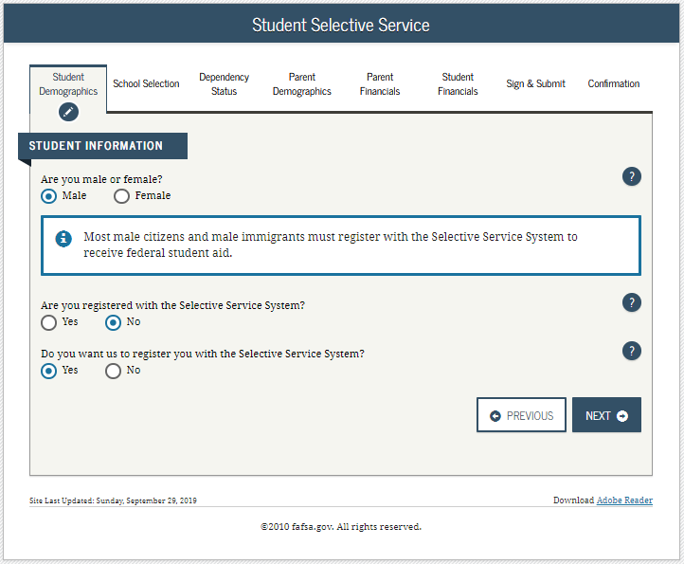
Dependent Student – Student Selective Service
Notes:
2021-22 “Student Selective Service” view.
Note: The response to this question is used to determine if the applicant needs to register with the Selective Service System (SSS). Most male citizens and male immigrants between the ages of 18–25 must register with the SSS to receive federal student aid. This requirement applies to any person assigned the sex of male at birth.

Slide 26
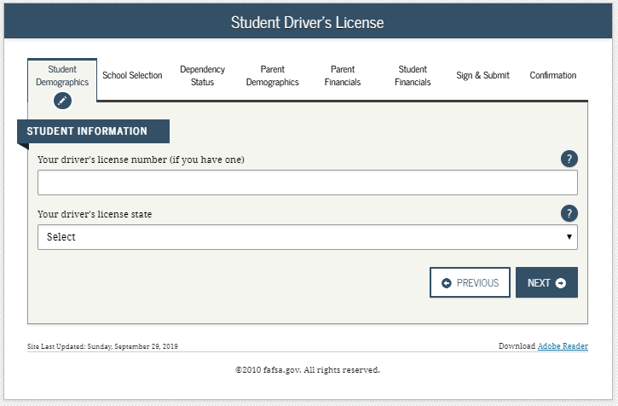
Dependent Student – Student Driver’s License
Notes:
2021-22 “Student Driver’s License” view.

Slide 27
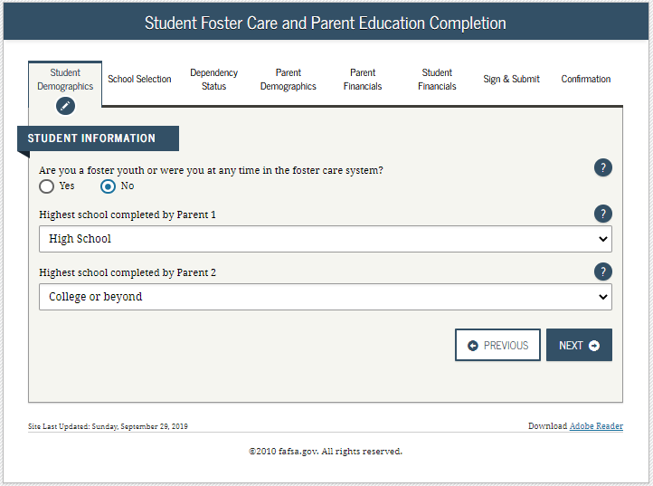
Dependent Student – Student Foster Care
Notes:
2021-22 “Student Foster Care and Parent Education Completion” view.

Slide 28
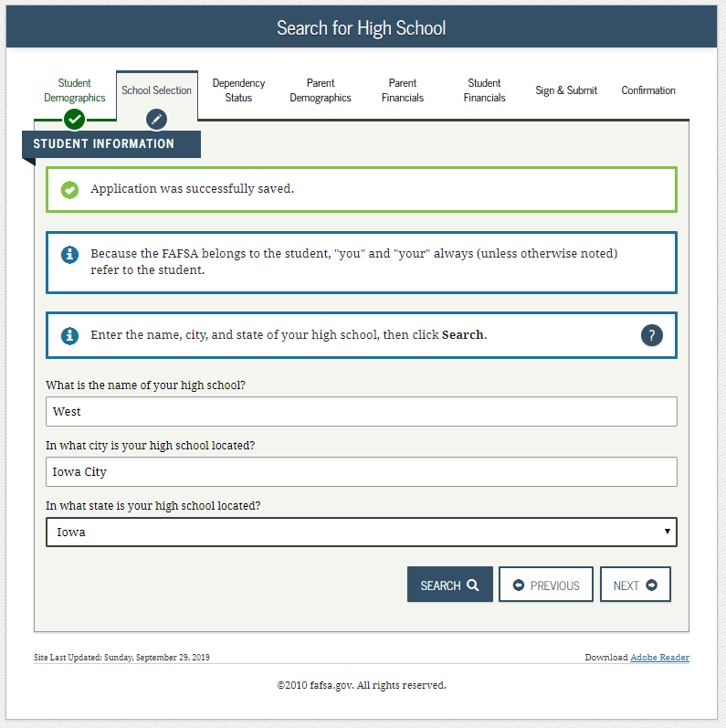
Dependent Student – Student HS Search
Notes:
2021-22 “Search for High School” view.
Note: This is the first page for the School Selection section.

Slide 29
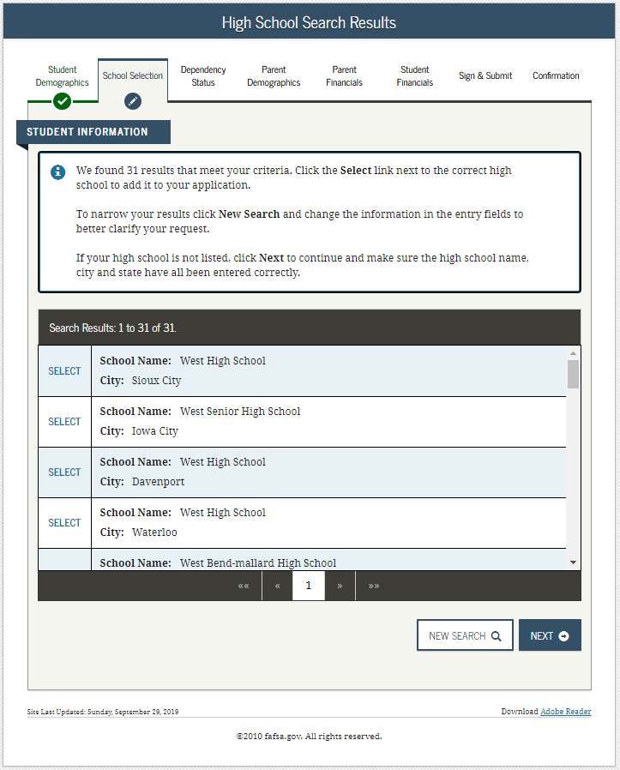
Dependent Student – Student HS Search Results
Notes:
2021-22 “High School Search Results” view.

Slide 30
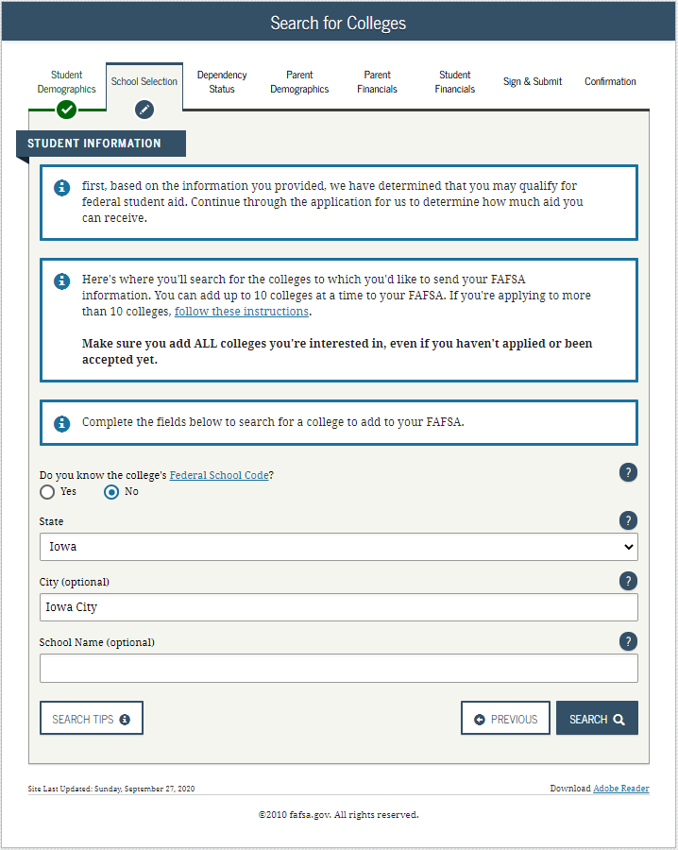
Dependent Student – Student Search for Colleges
Notes:
2021-22 “Search for Colleges” view.

Slide 31
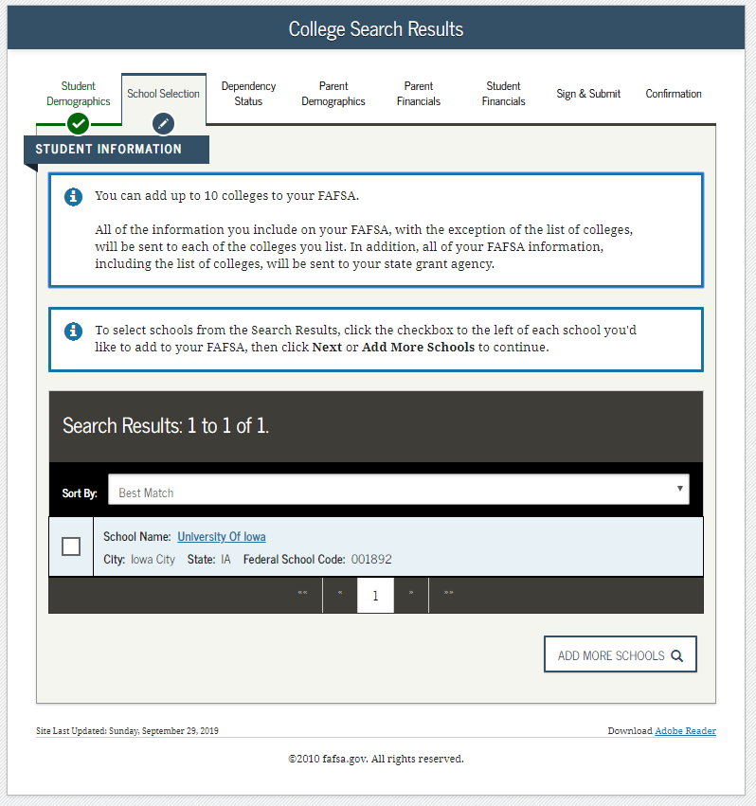
Dependent Student – Student Search for Colleges Results
Notes:
2021-22 “College Search Results” view.

Slide 32
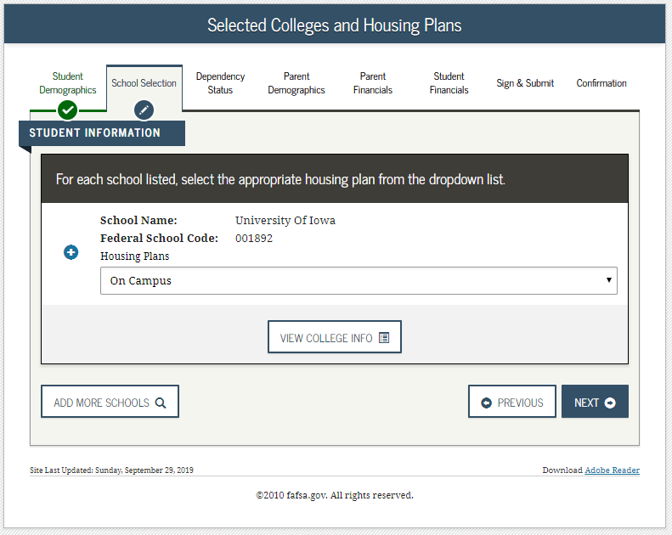
Dependent Student – Student Housing Plans
Notes:
2021-22 “Selected Colleges and Housing Plans” view.

Slide 33
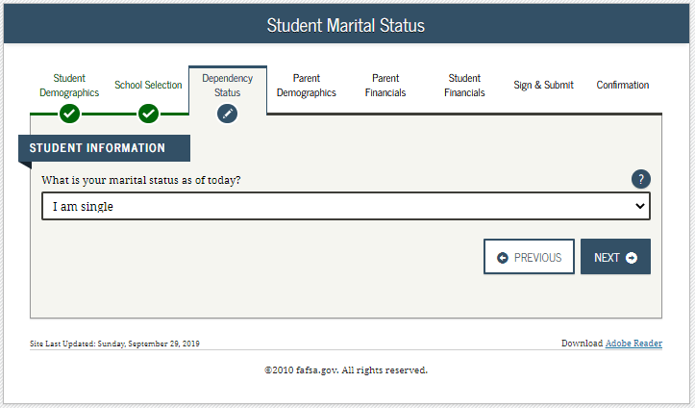
Dependent Student – Student Marital Status
Notes:
2021-22 “Student Marital Status” view.
Note: This is the first page of the Dependency Status section.

Slide 34
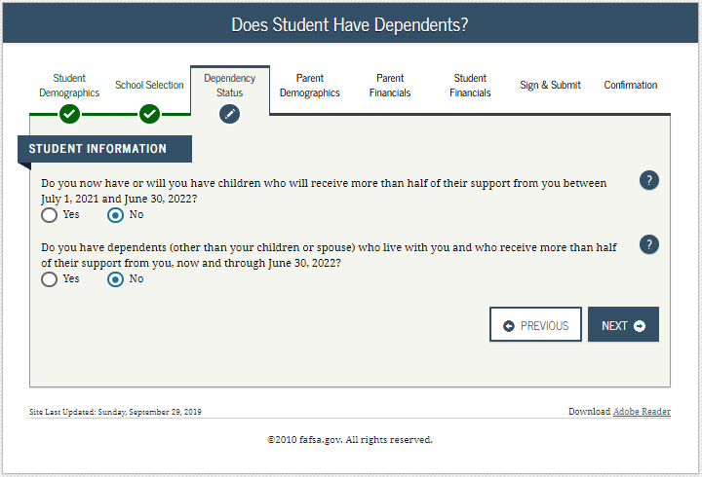
Dependent Student – Student Dependency Status 1
Notes:
2021-22 “Does Student Have Dependents?” view.

Slide 35
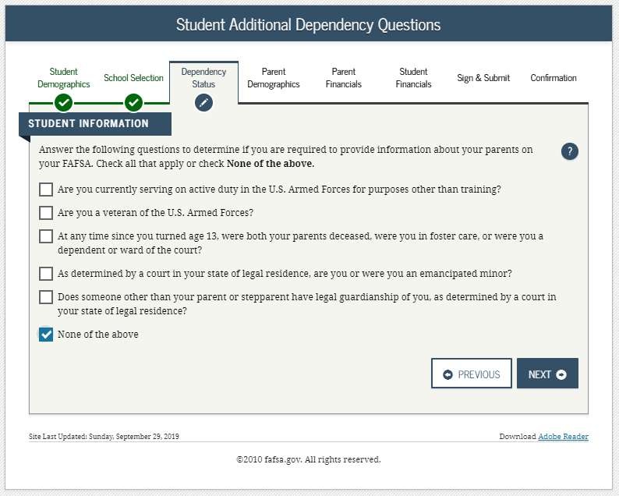
Dependent Student – Provide Parent Information 1
Notes:
2021-22 “Student Additional Dependency Questions” view.

Slide 36
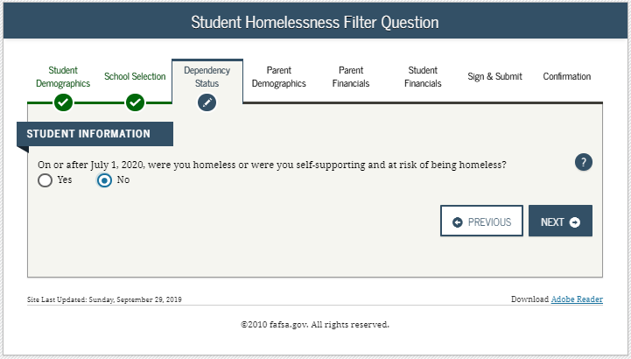
Dependent Student – Provide Parent Information 2
Notes:
2021-22 “Student Homelessness Filter Question” view.

Slide 37
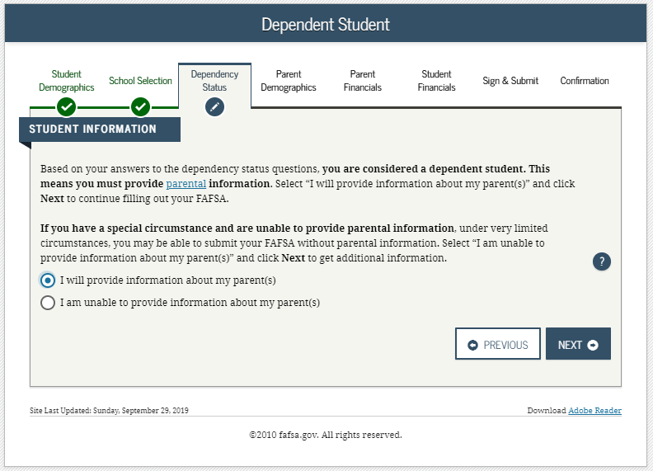
Dependent Student – Provide Parent Information 3
Notes:
2021-22 “Dependent Student” view.
This page only displays if it has been determined that the applicant is considered to be dependent.

Slide 38
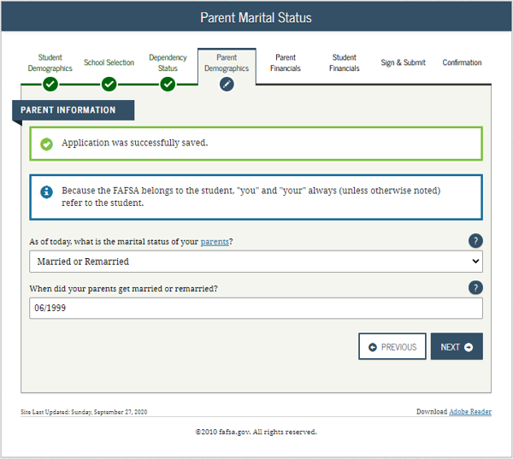
Dependent Student – Parent marital Status
Notes:
2021-22 “Parent Marital Status” view.
Note: This is the first view in the Parent Demographics section.

Slide 39
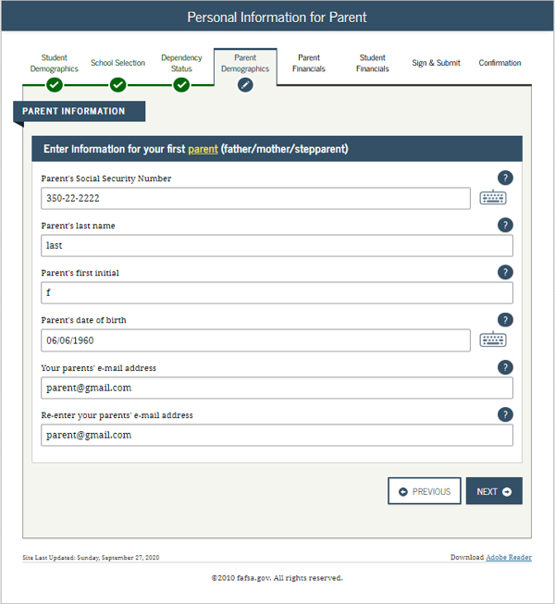
Dependent student – Personal information for parent
Notes:
2021-22 “Personal Information for Parent” view.

Slide 40
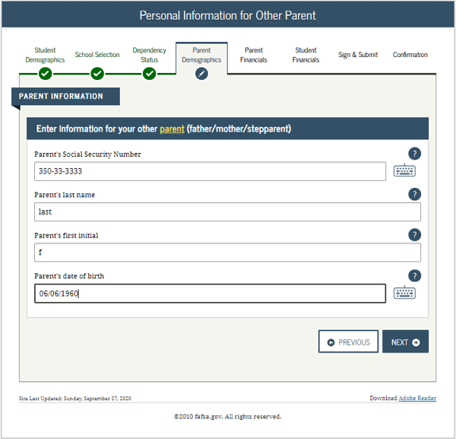
Dependent student – personal information for other parent
Notes:
2021-22 “Personal Information for Other Parent” view.

Slide 41
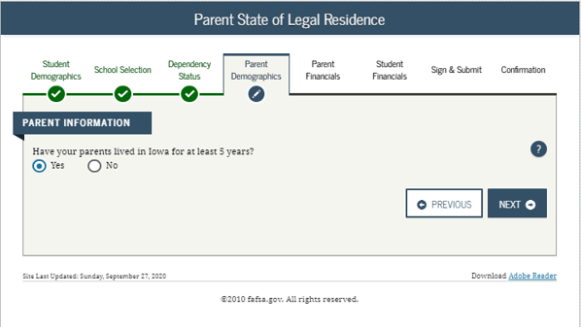
Dependent student – parent state of legal residence
Notes:
2021-22 “Parent State of Legal Residence” view.

Slide 42
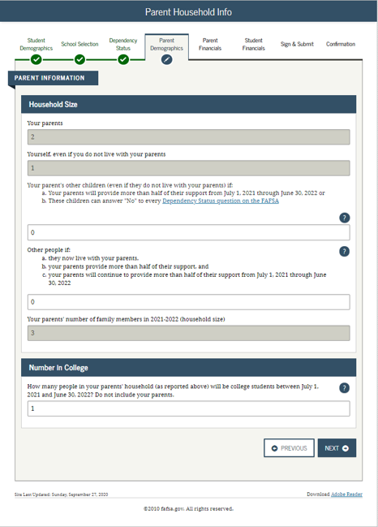
Dependent student – parent household info
Notes:
2021-22 “Parent Household Info” view.
Parents are required to complete the household size worksheet in an effort to get more accurate information about the number in the parent’s household and the number of those in the household who are in college. Some information will be prefilled, based on responses provided previously within the FAFSA form. The system tallies the totals as the parent completes the worksheet to ensure that there are no mathematical errors.

Slide 43
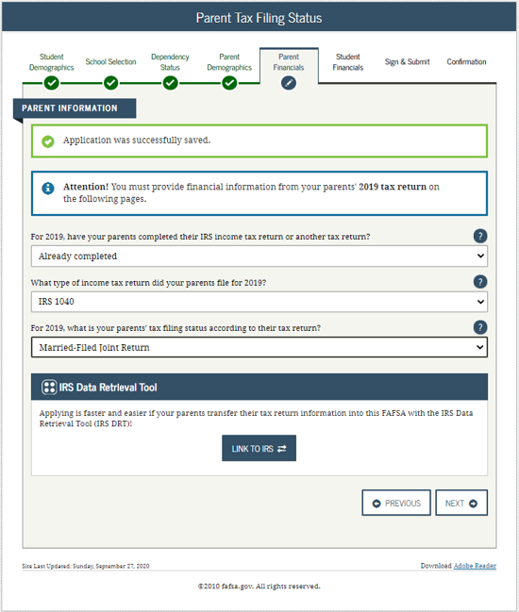
Dependent student – parent tax filing status
Notes:
2021-22 “Parent Tax Filing Status” view.
Note: This is the first view in the Parent Financials section.

Slide 44
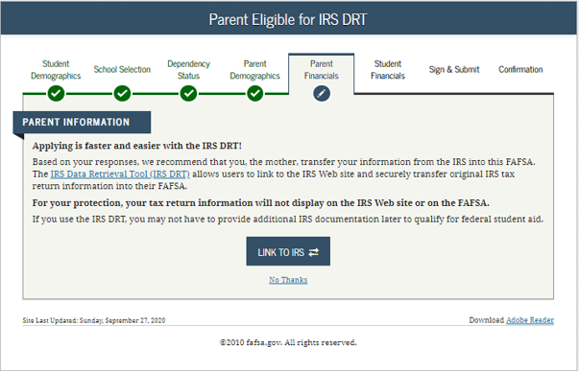
Dependent student – parent eligible for irs drt
Notes:
2021-22 “Parent Eligible for IRS DRT” view.
This view is displayed when the parent chooses not to use the IRS Data Retrieval Tool (DRT) on the previous view. An additional opportunity is presented to the parent to determine if they would like to link to the IRS for their financial information or to continue to enter it manually.

Slide 45
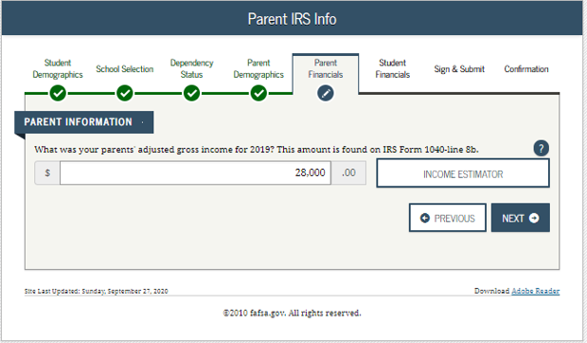
Dependent student – parent irs info
Notes:
2021-22 “Parent IRS Info” view.
Note: If the parent is either ineligible or decides not to use the IRS DRT, they will be required to enter their financial information manually.

Slide 46
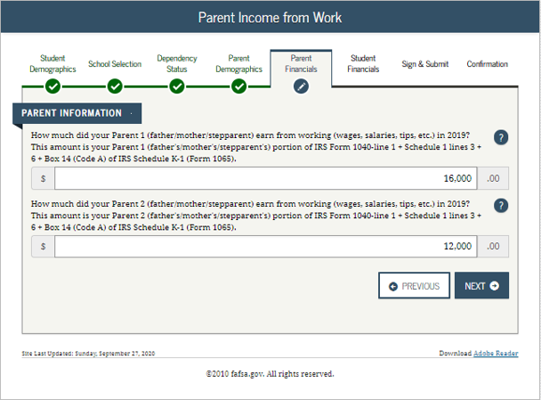
Dependent student – parent income from work
Notes:
2021-22 “Parent Income from Work” view.

Slide 47
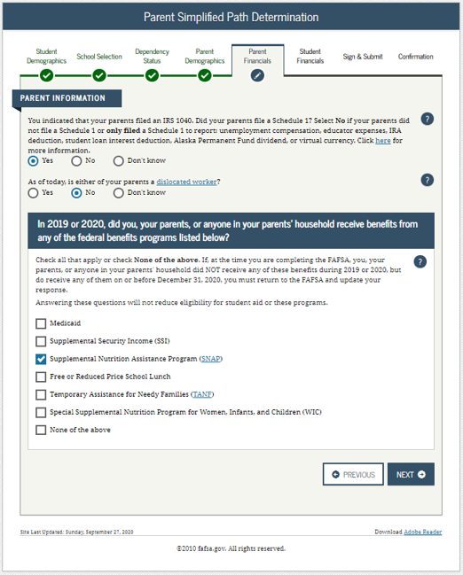
Dependent student – parent simplified path determination
Notes:
2021-22 “Parent Simplified Path Determination” view.
Instructional text will be dynamic based on the response to Parent Tax Return Status. In this example, the parent stated they “already filed” and “filed a 1040” in order to create the condition for schedule 1 dynamic text to display.
Note: The Schedule 1 question and associated help text have been updated to include all of the exceptions to answering this question. For the 21-22 cycle, capital gains and losses have been removed from the list of exceptions; reporting of virtual currency has been added.
In addition, the Schedule 1 question is now a field that can be transferred from the IRS DRT.
The Schedule 1 question may or may not be enabled based on previously answered questions.

Slide 48
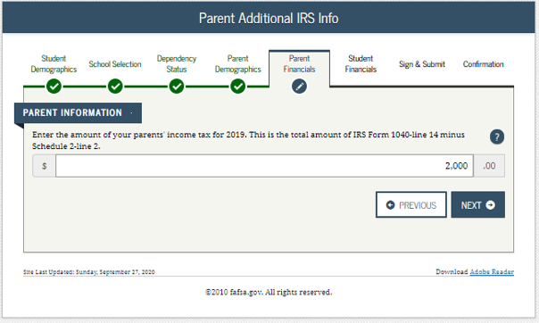
Dependent student – parent additional irs info
Notes:
2021-22 “Parent Additional IRS Info” view.

Slide 49
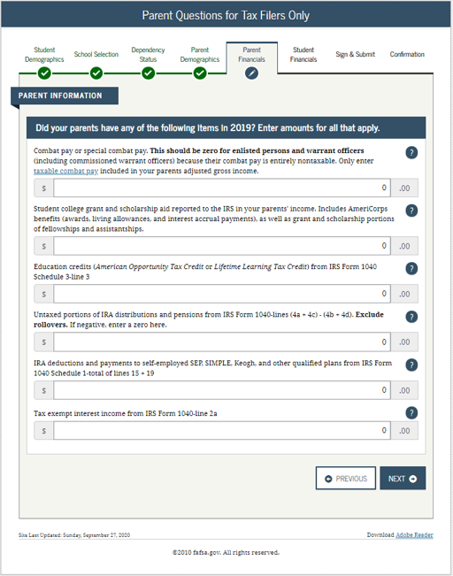
Dependent student – parent questions for tax filers only
Notes:
2021-22 “Parent Questions for Tax Filers Only” view.

Slide 50
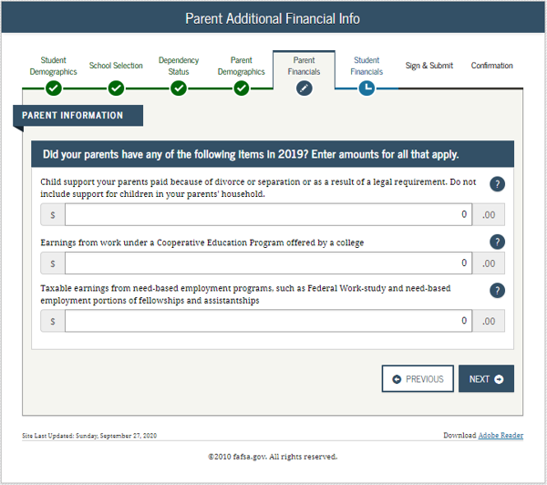
Dependent student – parent additional financial info
Notes:
2021-22 “Parent Additional Financial Info” view.

Slide 51
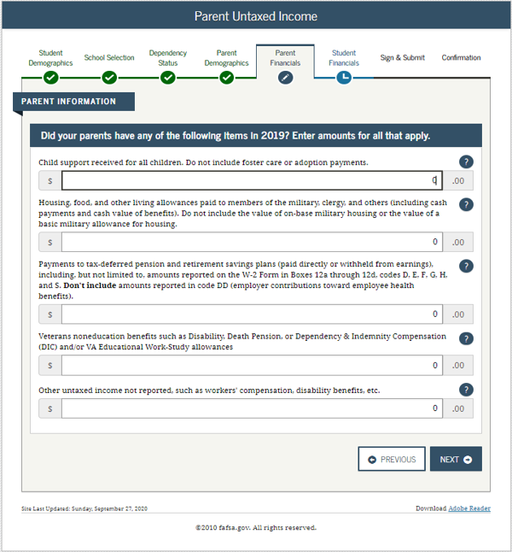
Dependent student – parent untaxed income
Notes:
2021-22 “Parent Untaxed Income” view.

Slide 52
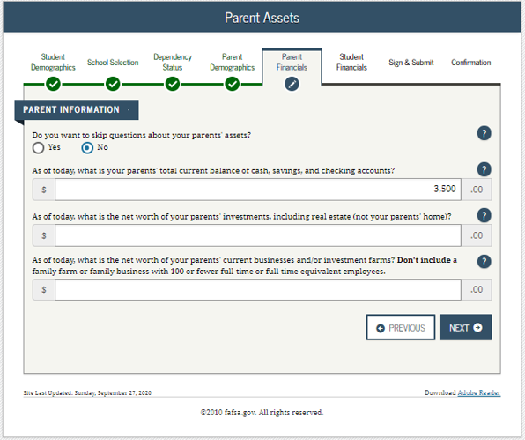
Dependent student – parent assets
Notes:
2021-22 “Parent Assets” view.
Note: Since the parents meet the simplified needs path determination criteria, the assets questions are optional.

Slide 53
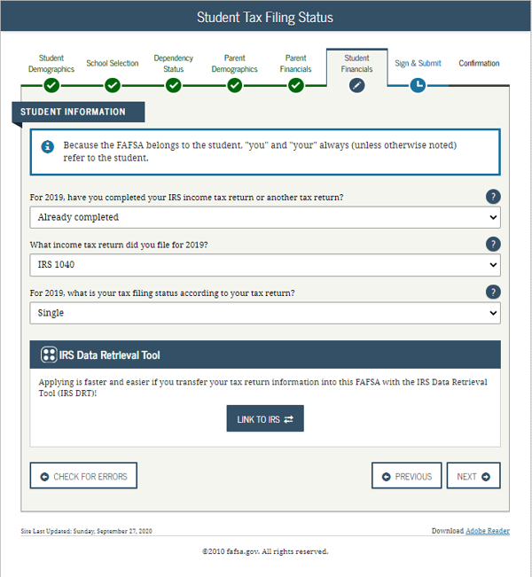
Dependent student- student tax filing status
Notes:
2021-22 “Student Tax Filing Status” view.

Slide 54
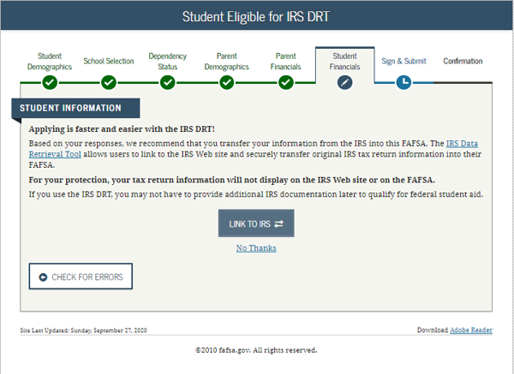
Dependent Student- Student Eligible for irs drt
Notes:
2021-22 “Student Eligible for IRS DRT” view.
This view is displayed when the applicant chooses not to use the IRS Data Retrieval Tool (DRT) on the previous view. An additional opportunity is presented to the applicant to determine if they would like to link to the IRS for their financial information or to continue to enter it manually.

Slide 55
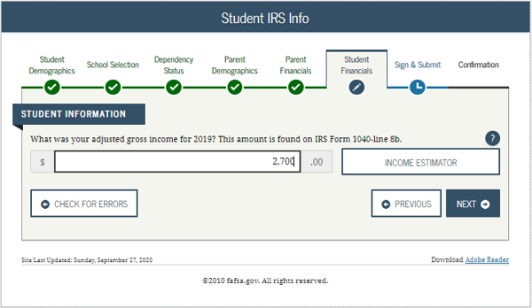
Dependent student- student irs info
Notes:
2021-22 “Student IRS Info” view.
Note: If the applicant is either ineligible or decides not to use the IRS DRT, they will be required to enter their financial information manually.

Slide 56
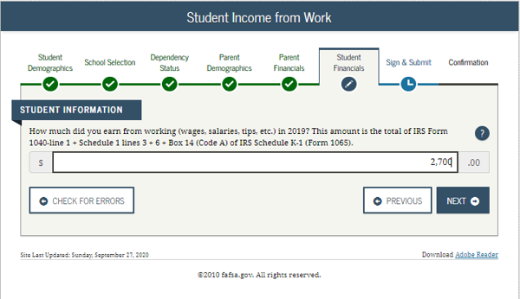
Dependent student- student income from work
Notes:
2021-22 “Student Income from Work” view.

Slide 57
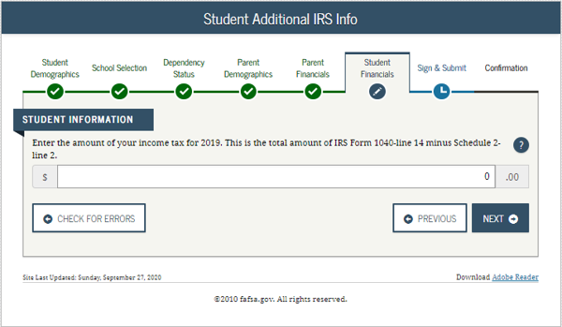
Dependent student- student additional irs info
Notes:
2021-22 “Student Additional IRS Info” view.

Slide 58
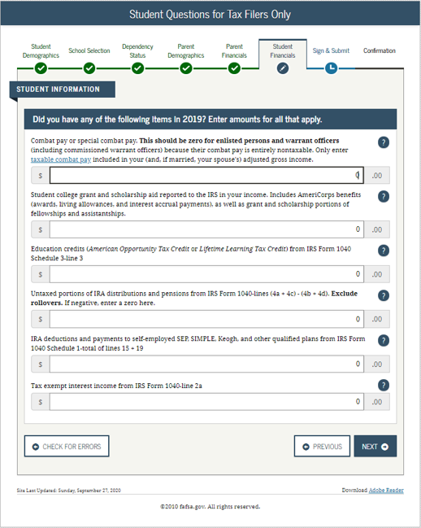
Dependent student- student questions for tax filers only
Notes:
2021-22 “Student Questions for Tax Filers Only” view.

Slide 59
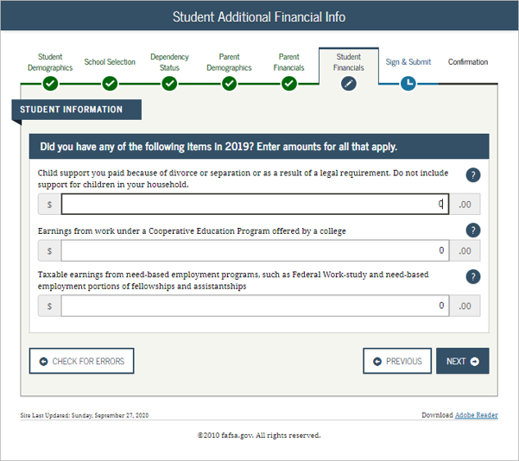
Dependent student- student additional financial info
Notes:
2021-22 “Student Additional Financial Info” view.

Slide 60

Dependent student- student untaxed income
Notes:
2021-22 “Student Untaxed Income” view.

Slide 61

Dependent student- student assets
Notes:
2021-22 “Student Assets” view.

Slide 62

Dependent student- preparer info
Notes:
2021-22 “Preparer Info” view.

Slide 63


Dependent student- FAFsa summary-student demographics and school selection
Notes:
2021-22 “FAFSA Summary” view – Student Demographics and School Selection.

Slide 64


Dependent student-fafsa summary-dependency status, parent demographics, and parent financials
Notes:
2021-22 “FAFSA Summary” view continued – Dependency Status, Parent Demographics and Parent Financials.

Slide 65


Dependent student-fafsa summary-parent financials continued, student financials, and sign and submit.
Notes:
2021-22 “FAFSA Summary” view continued– Parent Financials Continued, Student Financials, Sign & Submit.

Slide 66

Dependent student-signature status
Notes:
2021-22 “Signature Status” view.

Slide 67

Dependent student-agreement of terms for student
Notes:
2021-22 “Agreement of Terms” student view.
This is where the applicant acknowledges the Certification Statement.

Slide 68

Dependent student-signature options for student
Notes:
2021-22 “Signature Options” view for applicant.

Slide 69

Dependent student-signature status
Notes:
2021-22 “Signature Status” view.
Applicant signature accepted, and now the parent will need to sign.

Slide 70

Dependent student- which parent signs
Notes:
2021-22 “Which Parent Signs” view.
Allows the user to select which parent will be signing the application.
The choice between parents is only present if information was provided for two parents. Otherwise, this view does not display.

Slide 71

Dependent student- agreement of terms for parent
Notes:
2021-22 “Agreement of Terms” view for parent.
This is where the parent acknowledges the Certification Statement.

Slide 72

Dependent student- signature options for parent
Notes:
2021-22 “Signature Options” view for parent.
Parent FSA ID and password will not be required if the parent used the IRS DRT.

Slide 73

Dependent student- signature options for parent continued
Notes:
2021-22 “Signature Options” view for parent continued.
The parent of the applicant has the option to choose between three different ways of signing the application: Sign Electronically With My FSA ID, Print A Signature Page, or Submit Without Signatures. In this scenario the parent chose to sign the FAFSA form electronically.

Slide 74

Dependent student- signature status
Notes:
2021-22 “Signature Status” view.
Shows both applicant and parent signatures have been accepted.

Slide 75


Dependent student- confirmation page
Notes:
2021-22 “Confirmation Page” view.
Some states provide the option to transfer part of the applicant’s FAFSA information into a state aid application.
Parents of applicants are offered the option to transfer the parents’ data into another applicant's new FAFSA form by clicking the blue box saying “Does your brother or sister need to complete a FAFSA?”
If the applicant leaves the confirmation view before they click this link, they will not be able to return to transfer data to the application of a sibling.

Slide 76


Provide missing signatures- confirmation page
Notes:
2021-22 “Confirmation Page” view for dependent applicant after parent signature has been provided.

Slide 77


