Slide 1
Budgeting:
How to Budget Your Finances
Financial Literacy: Session 2

Slide 2
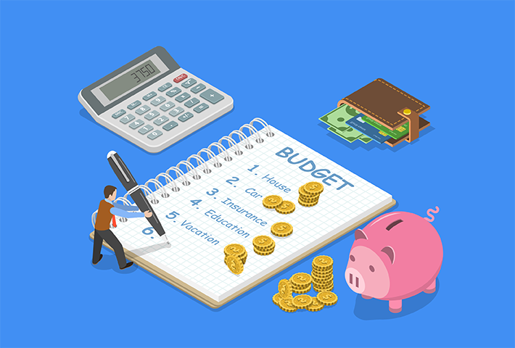
What is Budgeting?
https://youtu.be/6Ib-bdko5cE

Slide 3
The Importance of Budgeting
Prevents you from overspending
Allows you to be prepared for unpredictable emergencies
It sheds light on spending habits
Helps to save money in an organized manner

Slide 4
Budgeting Tips
Overestimate expenses
Underestimate your income
Be aware that things may go wrong and may need adjusting
Do not compare your income and expenses to others’
Set one or two days per week where you do not spend any money

Slide 5
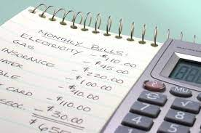
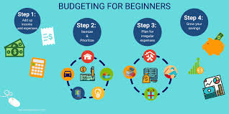
Applying What We Learned
Let’s create a budget in relation to your income!

Slide 6
Budgeting Reminder
https://www.youtube.com/watch?v=lQ6xxFktyag

Slide 7
Conclusion
Budgeting is a plan for your money which involves keeping track of both your income and savings.
Budgeting is important because spending more than you earn can cause financial stress. Budgeting helps you to limit spending and ensure that you have enough money for needs, wants, and savings
What is one interesting thing that you learned during today’s presentation?

